Slide 1
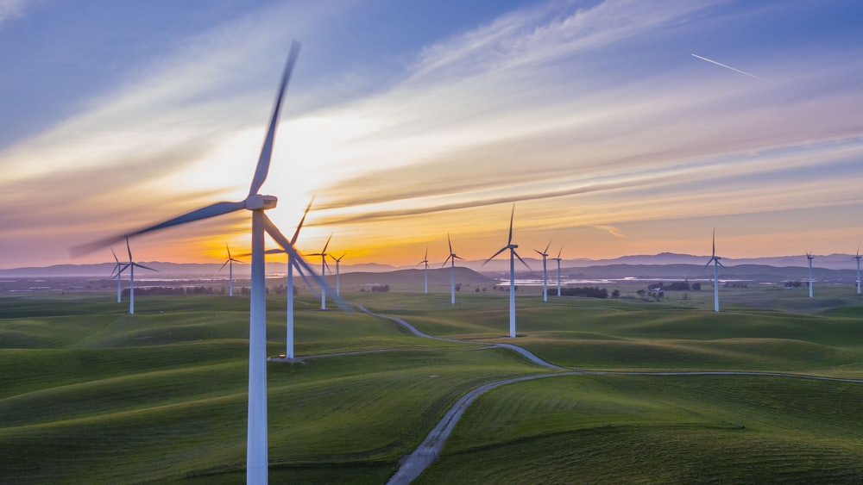
Unit No: 4 Wind Energy
Faculty: Rahul G. Suryavanshi

Slide 2
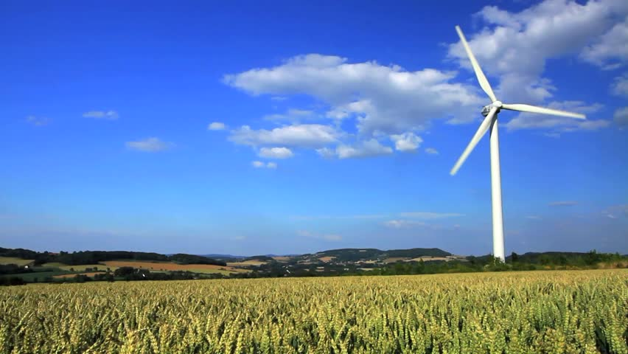
Syllabus:
Introduction,
wind and its properties,
wind energy scenario –World and India.
Basic principles of Wind Energy Conversion Systems (WECS),
Classification of WECS,
parts of WECS,
derivation for Power in the wind,
wind site selection consideration,
advantages and disadvantages of WECS.

Slide 3
Introduction
Wind energy is the kinetic energy associated with the movement of large masses of air.
These motions result in uneven heating of the atmosphere creating temperature, pressure and density difference.
https://www.youtube.com/watch?v=Z1hHynbleB8

Slide 4
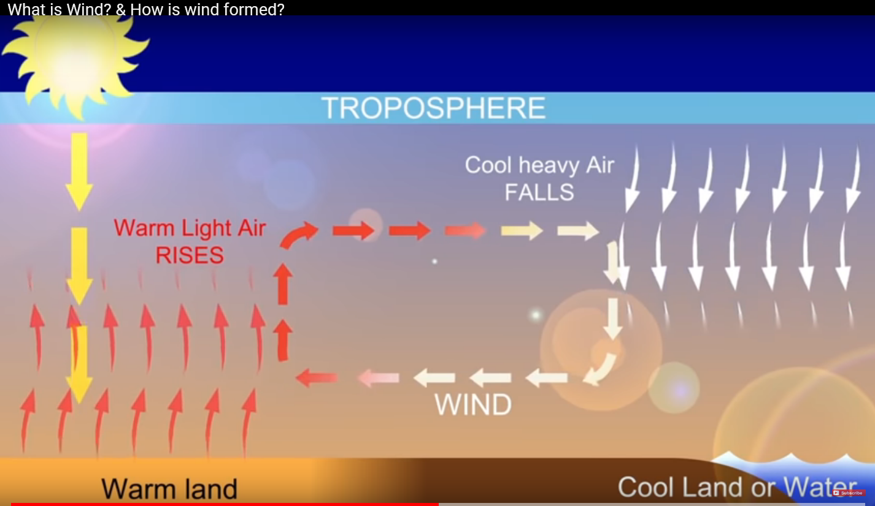
Formation of wind:

Slide 5
Wind energy was one of the 1st natural energy source used by mankind for various applications such as,
Water pumping (2000 to 1700 B.C.➔ China)
Sail the ships (Egyptians ➔ 5000 years ago)
Grinding the grains (Persian and Afghanistan➔ 7th century AD)
Europeans imported this technology in 12th century and by 1750, Holland had around 8000 wind mill and England had 10,000.
After the invention of steam engine in 18th century, windmill use declined.
In 1890 at Denmark, 1st electric power generation through wind was proposed.

Slide 6
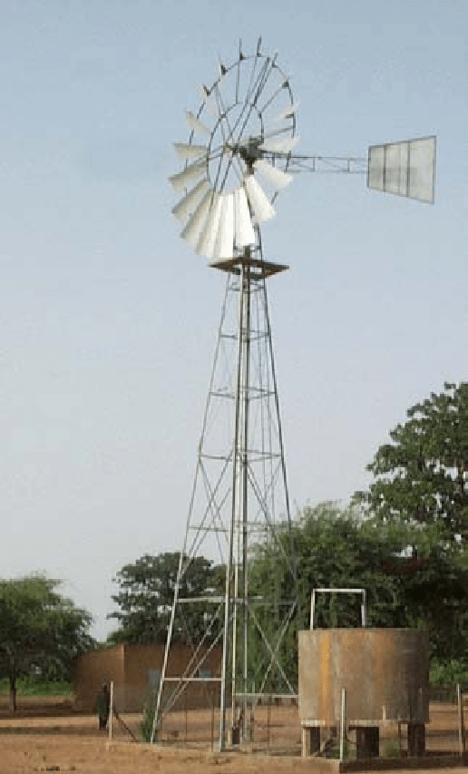
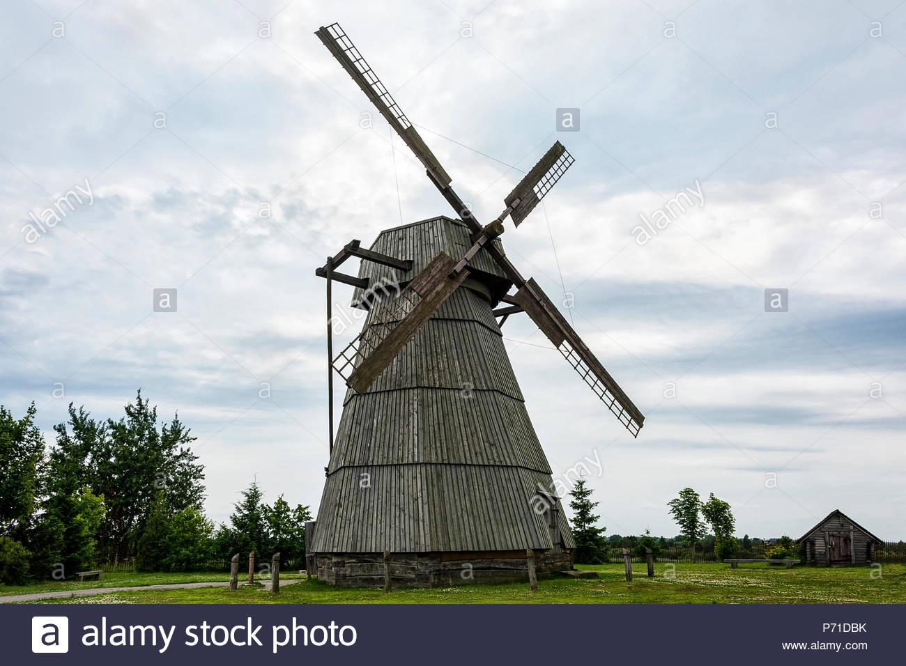
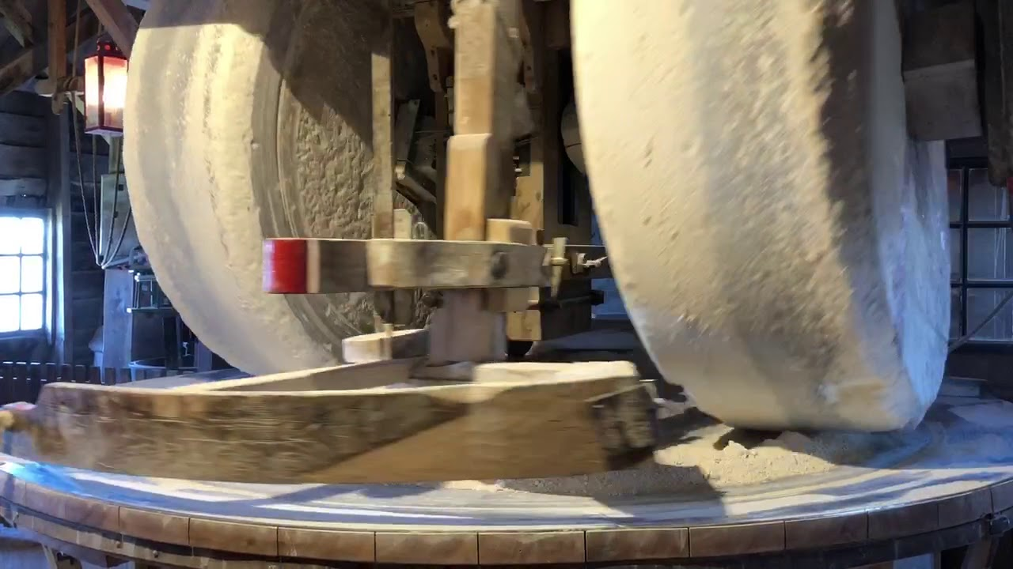

Slide 7
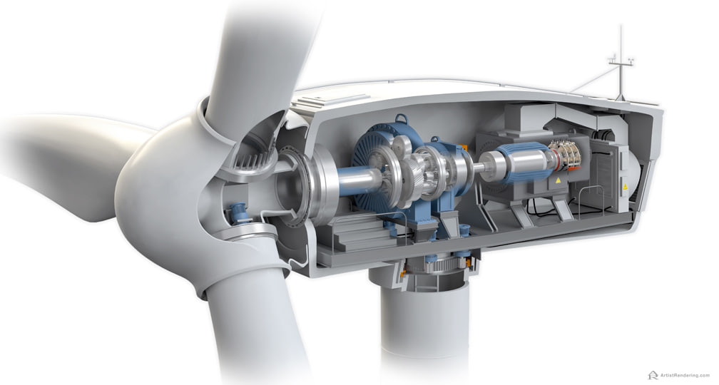
Wind energy generation

Slide 8
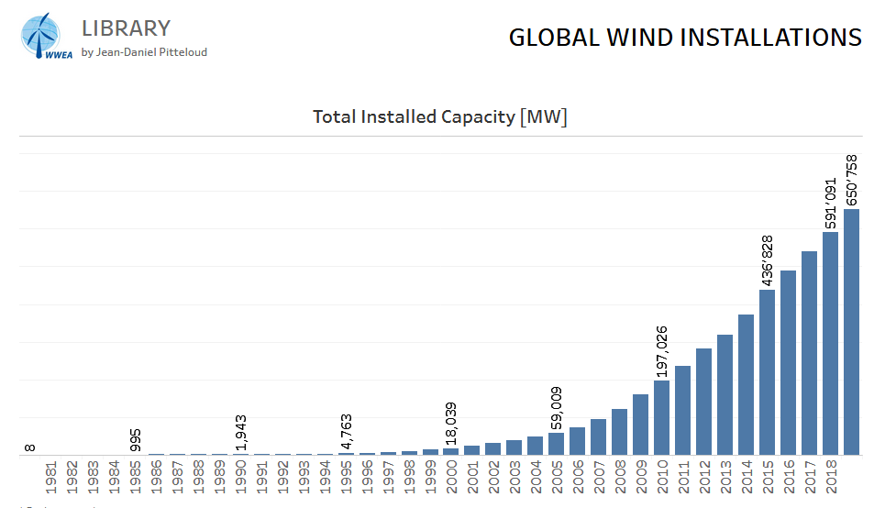
wind energy scenario- World and India

Slide 9
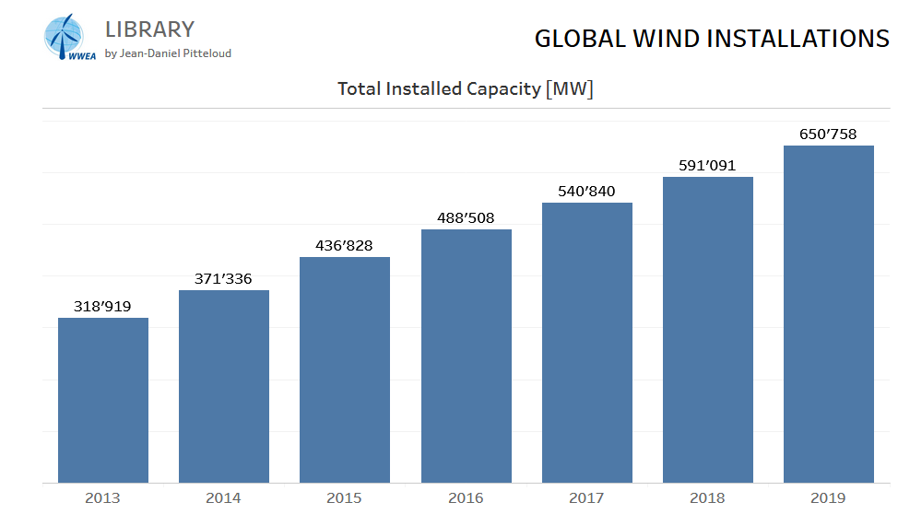

Slide 10
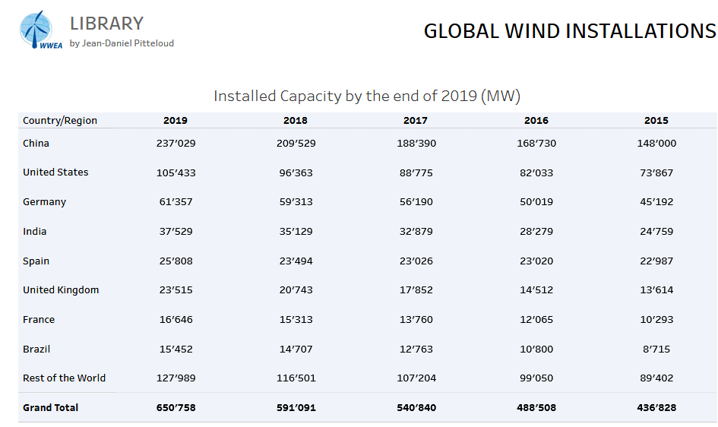

Slide 11
Global Wind speed
https://globalwindatlas.info/

Slide 12
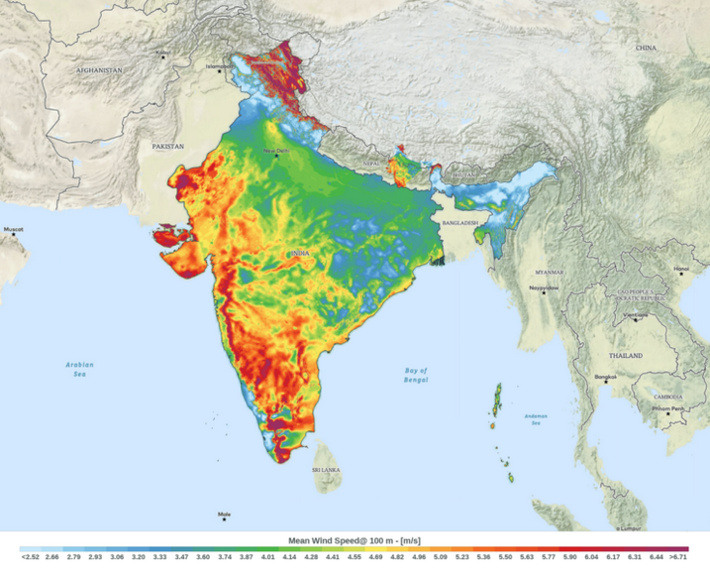
Wind Speed in India

Slide 13
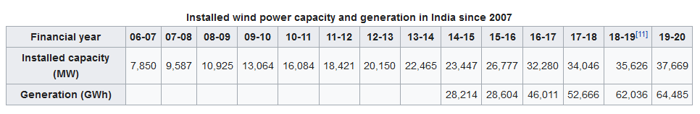

Slide 14
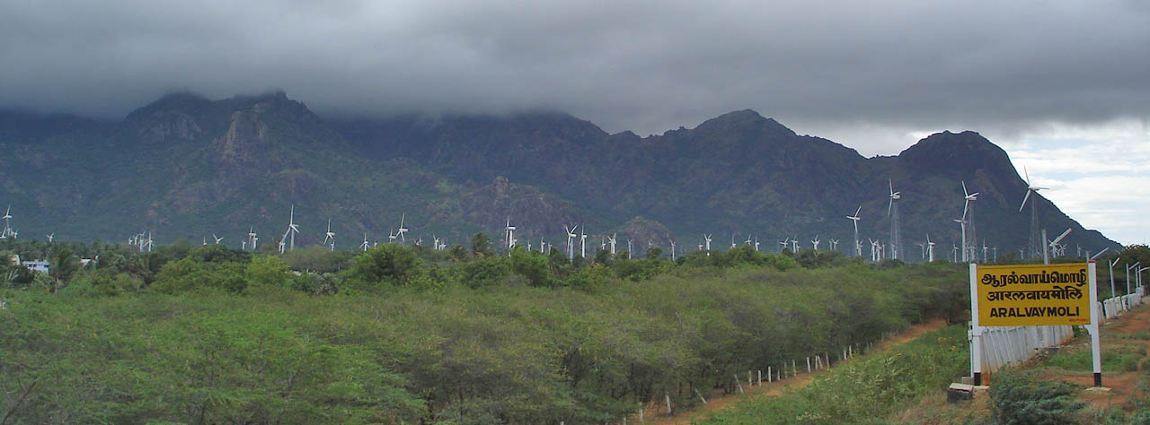
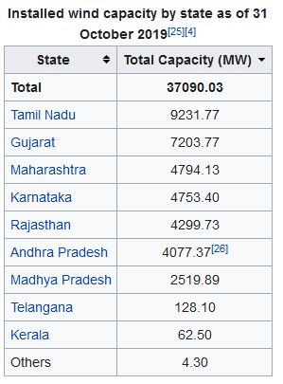

Slide 15
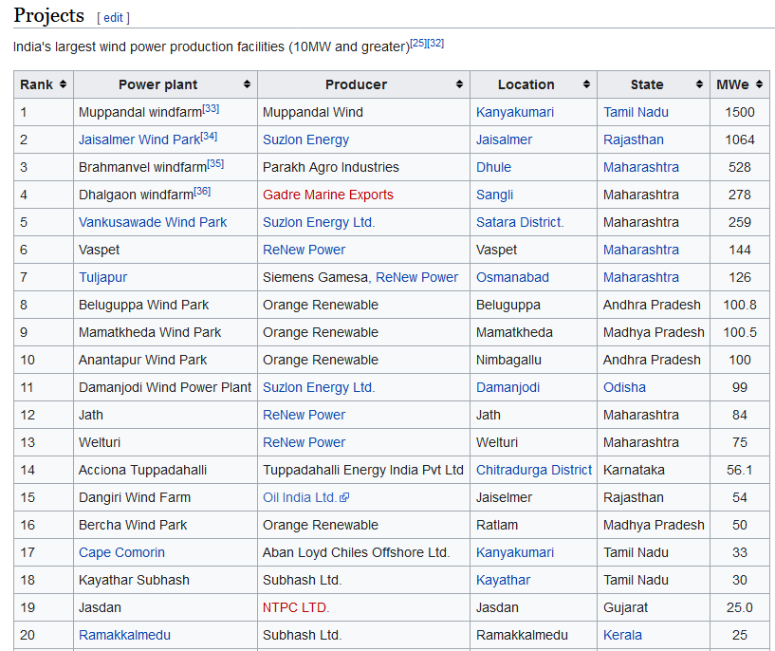

Slide 16
Link for top wind projects in India: https://en.wikipedia.org/wiki/Wind_power_in_India
World wind energy scenario:
https://en.wikipedia.org/wiki/Wind_power_by_country

Slide 17
Basic principles of Wind Energy Conversion Systems (WECS),
The wind mill works on the principle of converting Kinetic energy of the wind to mechanical energy which is further converted into electrical energy.
There are two main mechanisms for converting the kinetic energy of the wind into mechanical work; both depend on slowing the wind and thereby extracting kinetic energy.
The crudest, and least efficient technique is to use drag;
drag is developed simply by obstructing the wind and creating turbulence and the drag force acts in the same direction as the wind.
This works by exposing a flat area on one side of a rotor to the wind while shielding (or reefing the sails) on the other side; the resulting differential drag force turns the rotor.
The other method, used for all the more efficient types of windmill, is to produce lift.
Lift is produced when a sail or a flat surface is mounted at a small angle to the wind;
This slightly deflects the wind and produces a large force perpendicular to the direction of the wind with a much smaller drag force.
It is this principle by which a sailing ship can tack at speeds greater than the wind.
Lift mainly deflects the wind and extracts kinetic energy
.

Slide 18
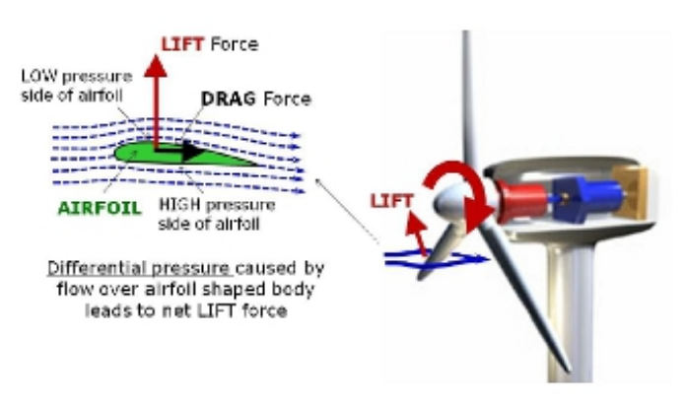

Slide 19
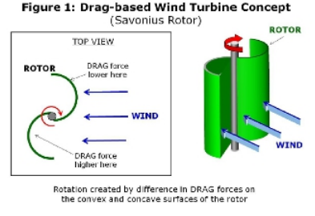

Slide 20
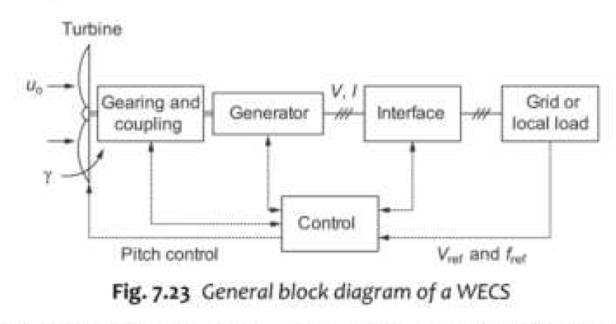
Block diagram of WECS:
WECS can be either grid tie or off grid systems
Grid tie systems are most commonly used.

Slide 21
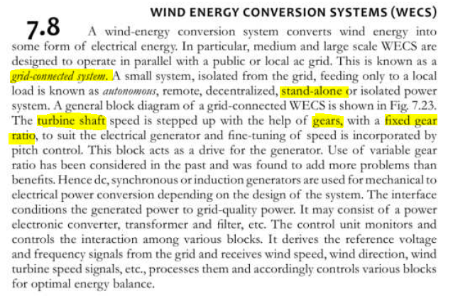

Slide 22
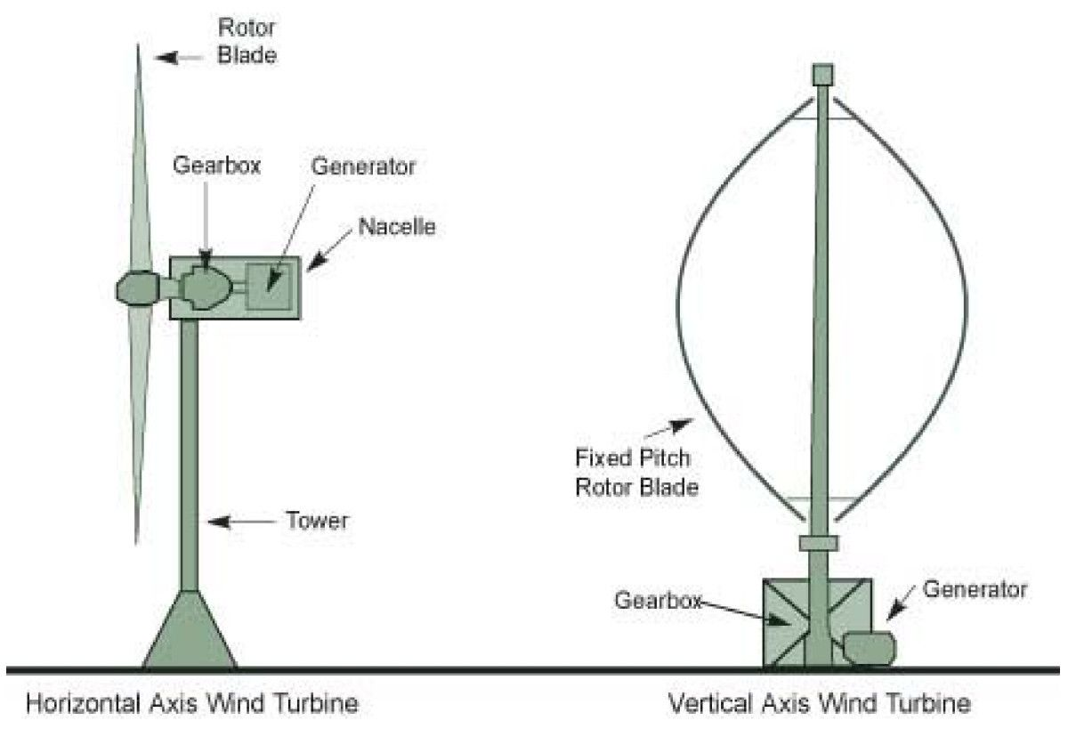
Classification of WECS
WECS are broadly classified into 2 categories:
Horizontal-axis turbines: The axis of the rotation is parallel to the air stream (horizontal)
Vertical-axis turbines: The axis of the rotation is perpendicular to the air stream (vertical)

Slide 23
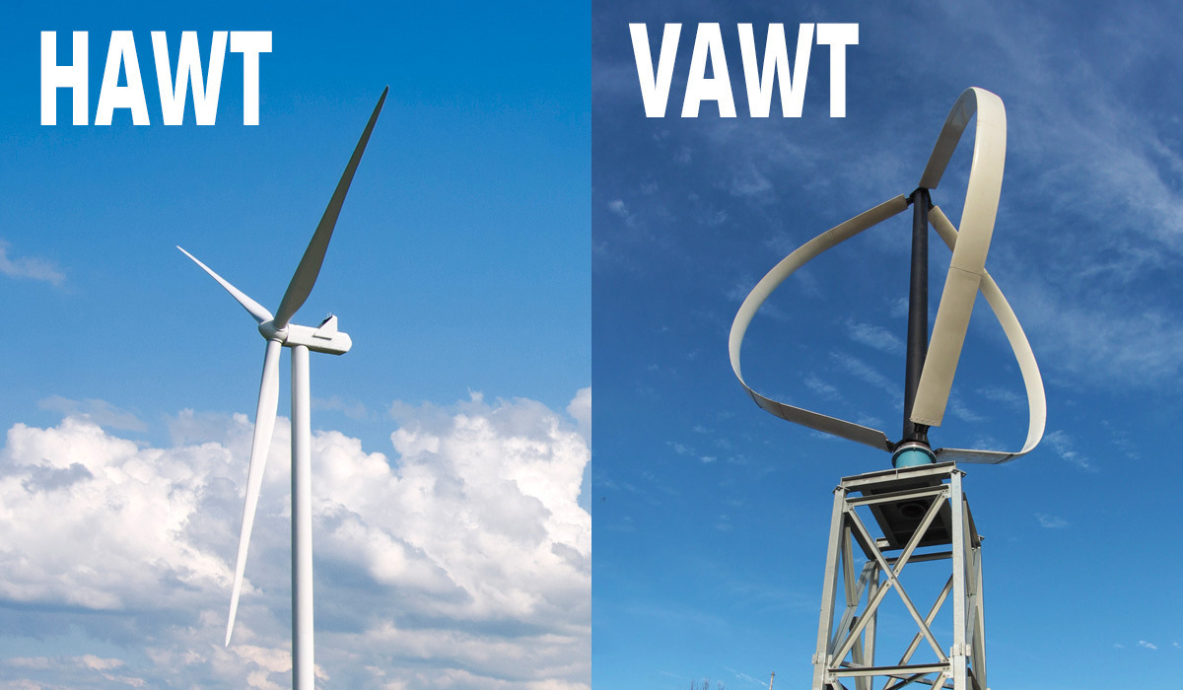

Slide 24
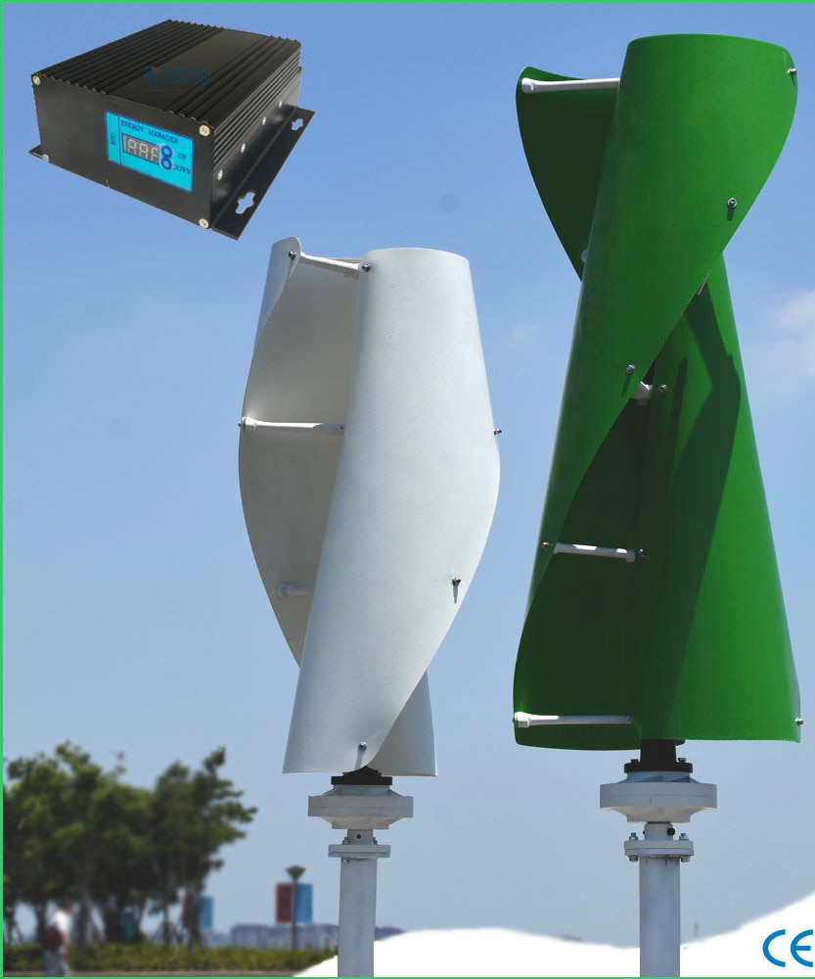

Slide 25
Working of horizontal axis wind turbine:
https://www.youtube.com/watch?v=qSWm_nprfqE

Slide 26
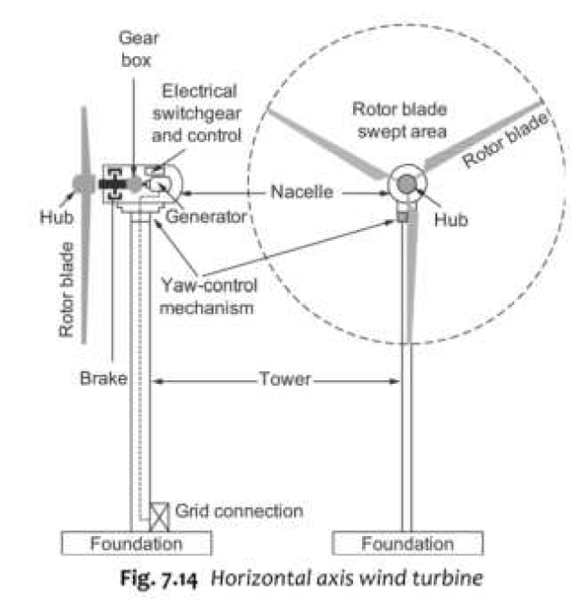
Parts of WECS
Horizontal Axis Wind Turbine:
The main components are:
Rotor Blades
Hub
Nacelle
Yaw control mechanism
Tower

Slide 27
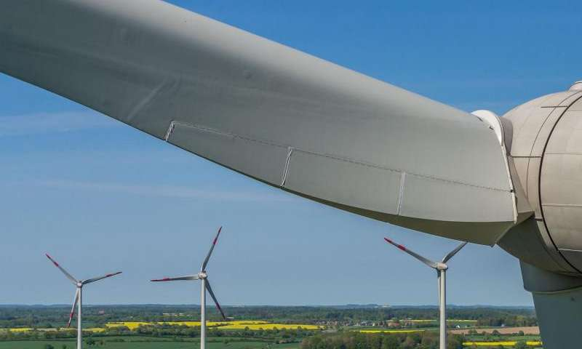
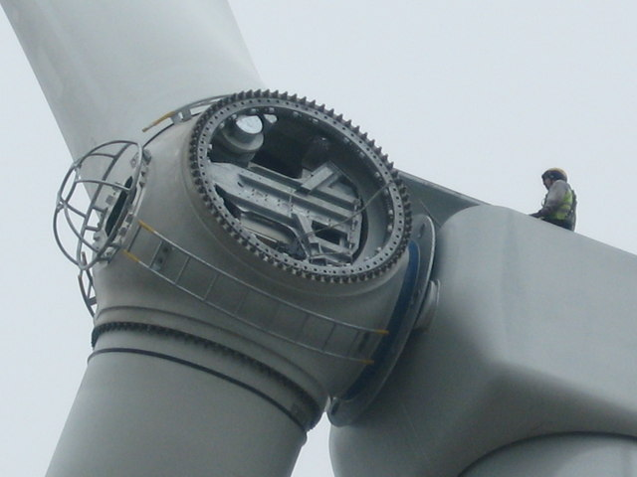
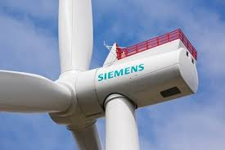
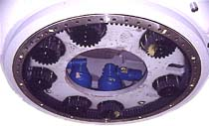

Slide 29
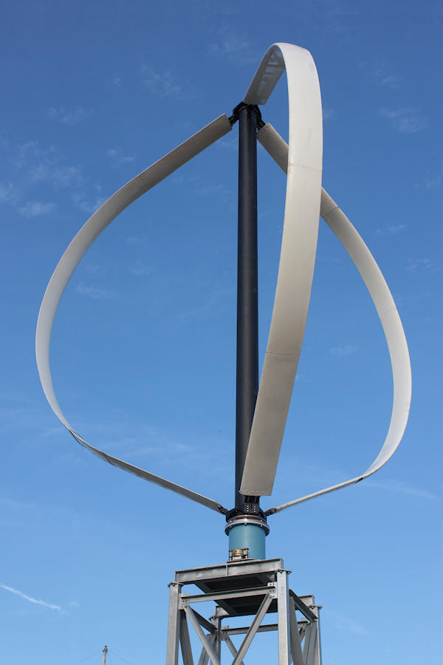
Vertical Axis Wind Turbine:
Accepts wind from any direction so no need of yaw control
Gear box, generator etc are located on the ground eliminate the need of heavy nacelle at the top.
Inspection and maintenance becomes easy.
Reduces overall cost.

Slide 30
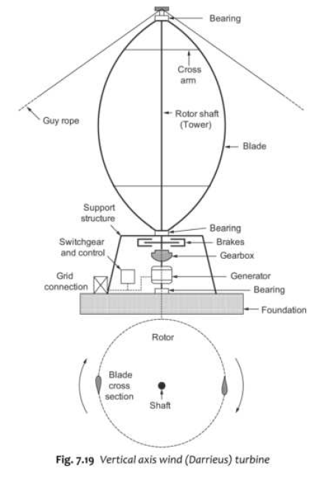
Parts of VAWT:
Tower (Rotor shaft)
Blades
Support structure

